Slide 1
Curriculum Night
First Grade
August 21, 2018

Slide 2
Our First Grade Team!
Mrs. Raj Ms. Hartford
Mrs. Lavelle Mrs. Comesana
Mrs. Martin Ms. Moses

Slide 3
Where can I find the standards?
Visit www.georgiastandards.org to see individual standards that we cover in first grade. ☺

Slide 4
Math
6 different Fulton County units of study approximately 5-6 weeks long based on the Georgia Standards of Excellence
Standardized tests for each unit
First grade supports 3 levels of continuous achievement- on, advanced and accelerated
Math placement are reevaluated at the end of each semester as set by Fulton County Guidelines.
Please contact Sarah Gruber with any placement questions: grubers@fultonschools.org

Slide 5
Reading
All students are formally assessed 3 times per year using multiple assessments (computer based as well as teacher 1:1)
Each child will work on his/her own individual/instructional Benchmark reading levels (BAS)
Weekly classwork & homework on decoding skills as well as comprehension skills
Goal is 1 full year’s growth

Slide 6
Reading Levels

Slide 7
Writing
We will focus on narrative, informational, and persuasive genres. (9 week units)
Writing folder – will be coming home soon to complete as a family project ☺
Summative assessments are given every 9 weeks.

Slide 8
Social Studies and Science
Social Studies
Our World
George Washington Carver
Thomas Jefferson
Ben Franklin
Ruby Bridges
Lewis and Clark
Theodore
Roosevelt
Science
Light and Shadows
Sound
Magnets
Weather
Living Things

Slide 9
Homework
A homework sheet will come home every Monday for spelling and reading.
It is due on Friday. Please sign & return.
Reading for 10-15 minutes EVERY night. Your child will receive a special reading envelope with books each week.
Math homework will come from your child’s math teacher.
Notes:
Mon/wed- reading Tues-math Thursday-math/spelling

Slide 10
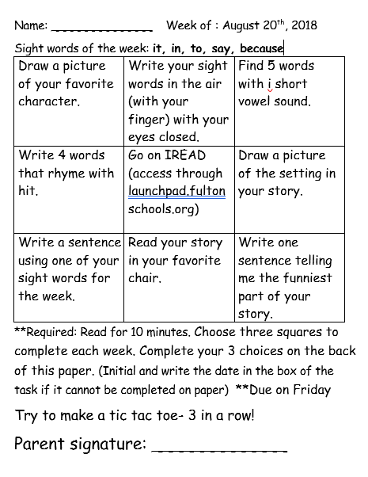

Slide 11
Sight words/ Spelling words
This year, we will be working on not only reading
sight words, but spelling sight words correctly during
writing units.
*Each week, your child will learn 5 new sight words.
*The children are expected to use the correct
spelling for these sight words once they have
learned them.
They should also be able to build new words off of these base words.
*Example: Once your child has learned “at”, they
should be able to spell “cat” or “that”.
Notes:
Mon/wed- reading Tues-math Thursday-math/spelling

Slide 12
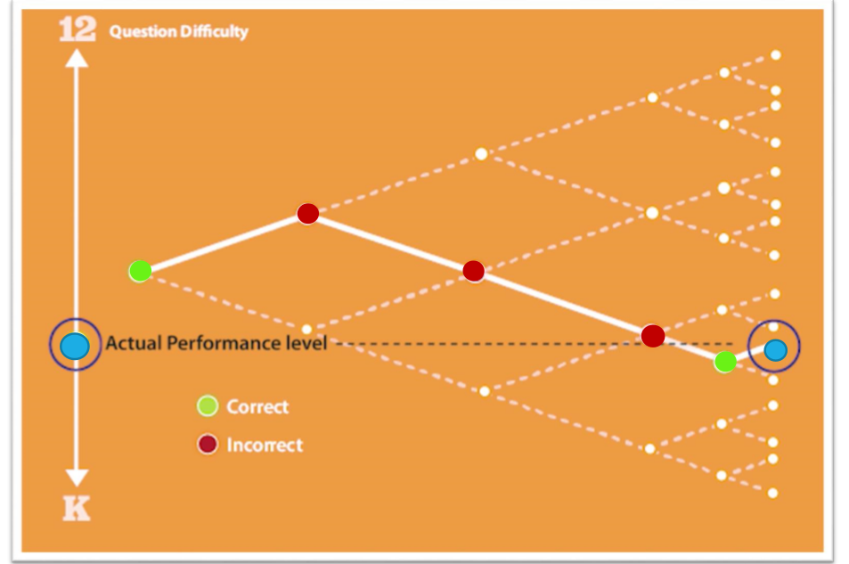
How does our computerized testing work?

Slide 13
Grading
S -Satisfactory (75%-100%)
N -Needs Improvement (65%-74%)
U -Unsatisfactory (64% and lower)
Report cards every 9 weeks.
Progress Skills Checklists 3 times a year.
Work Sample Packets approximately twice a month on Tuesdays. Sign and return the packet.
Minimum of 9 grades per subject per semester
Grades can be found in Home Access Center
Notes:
80-100, 70-79, 69 and below

Slide 14
Classroom Behavior Plan
Variety of behavior management tools in first grade, please see you teachers website, newsletter, or email for more details
PURR tickets
If your child needs extra support, we will work together to create a customized behavior plan.

Slide 15
Want to know more?
www.fultonschools.org
https://www.georgiastandards.org/Georgia-Standards/Pages/default.aspx
www.statebridgecrossing.com
www.firstgradesbce.weebly.com
Individual teachers websites

Slide 16
Communication/Misc
Work Sample Packets: twice a month on Tuesday’s
GO Home Folder – will come home everyday to be checked for important papers. Should come back each morning EMPTY or with signed papers.
Remember to send in a written note when your child is absent or there is a transportation change!
Please send 1 healthy snack for your child each day

Slide 17
Thank you for joining us tonight! We are looking forward to a wonderful year together!

